Slide 1

Securing Industry Secrets: Harnessing LSB Embedding in Image Steganography
SANJAY M
VIT CHENNAI CAMPUS
1

Slide 2


Introduction
INPUT
Ceaser Cipher
LSB
Ceaser Cipher
Output
In today's digital world, security of industry secrets is Mandatory.
Image steganography
Least Signiﬁcant Bit (LSB ) embedding in image steganography
Hide sensitive information
Involves replacing the least signiﬁcant bits of image pixels with secret data
TEXT + IMAGE = IMAGE = IMAGE + TEXT
Ensures conﬁdentiality and integrity of data.
steganography aim to achieve imperceptibility while maintaining robustness against attacks.
.
.
2

Slide 3
Literature Review
Advancements in LSB-based Techniques: Several studies introduce novel LSB (Least Significant Bit) matching algorithms and variations to improve data hiding methods.
Hybrid Approaches for Enhanced Security: Researchers explore hybrid methods combining steganography with encryption algorithms like RSA, Caesar Cipher, and chaotic mapping to improve security and resist detection attempts.
Focus on Visual Quality and Security: Many research efforts emphasize improving visual quality, embedding capacity, and security against steganalysis detection attempts.
Diverse Applications and Future Directions: The studies cover a wide range of applications, including digital watermarking for copyright protection, steganography in multimedia files, and even concealing malware in video streams.
3

Slide 4

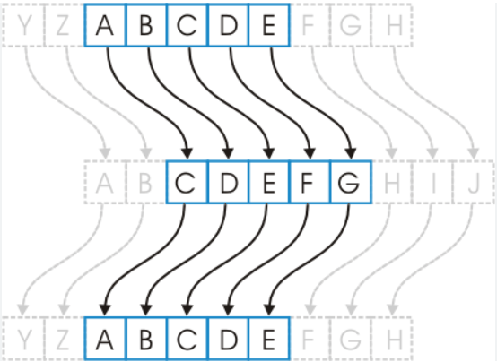
Ceaser Cipher
classic encryption technique
English alphabet (A - Z as 0 - 25)
key=3
Encryption Process : A shifted to c
Decryption Process : C shifted to A
4

Slide 5

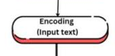
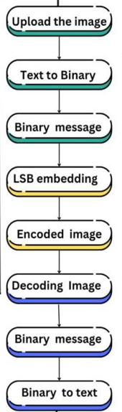


Understanding LSB Embedding
Least Signiﬁcant Bit (LSB) embedding involves replacing the least signiﬁcant bits of image pixels with the Text data.
This technique is virtually undetectable to the human eye, making it an ideal method for safe communication and data protection.
5

Slide 6
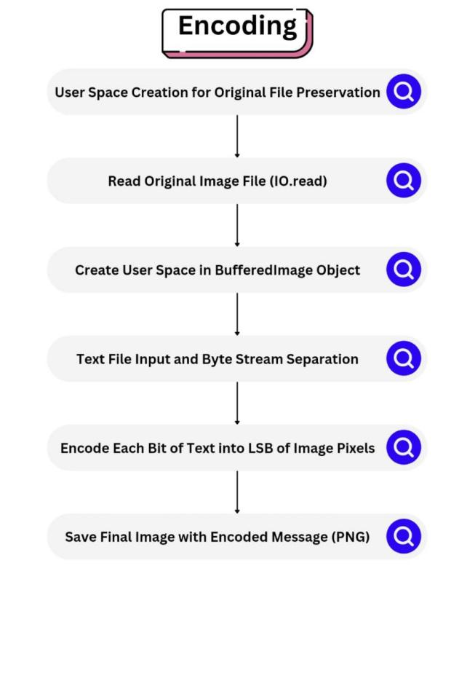
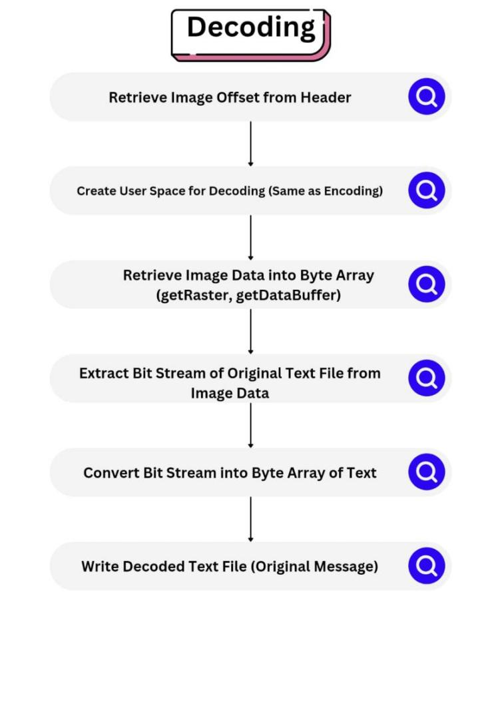
LSB WORKING METHOD
6

Slide 7

Beneﬁts of Image Steganography
Data security
To conceal sensitive information
Undetectable to the human eyes
Data protection
Safe communication
Unauthorized parties Can’t detect or intercept the hidden content
7

Slide 8


Challenges
Limited Power of Human Vision System
Protecting Data
Safe communication
Confidential Information sharing
Payload Capacity, Security
8

Slide 9

Applications in Industry
Protecting Trade Secrets
Secure Communication
Lets’s see Industries such as Manufacturing, ﬁnance, and software beneﬁt from this technique to safeguard critical information.
9

Slide 10
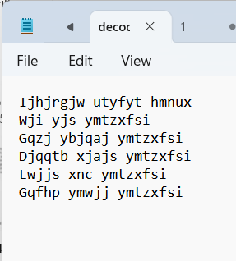



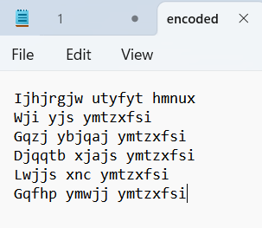
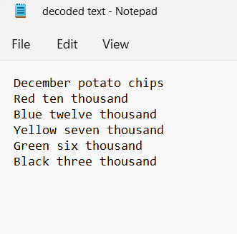
Manufacturing Industry
.
10

Slide 11

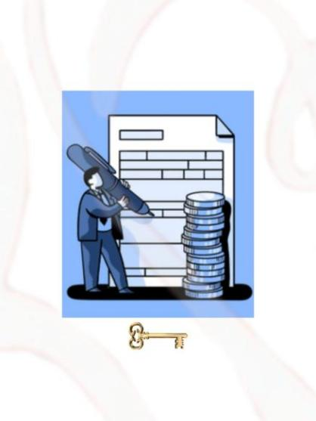
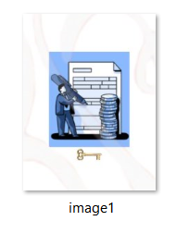
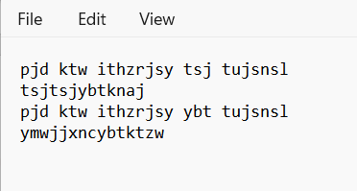
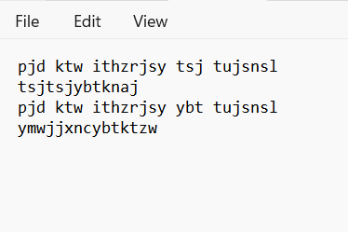
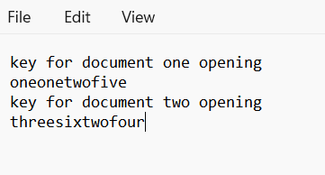
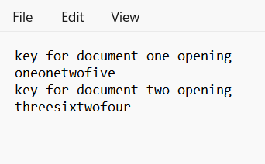
Software Industry
11
Notes:
BALAJI JAYAKRISHNAN
Associate Professor
VIT Business School Chennai
balaji.jayakrishnan@vit.ac.in

Slide 12
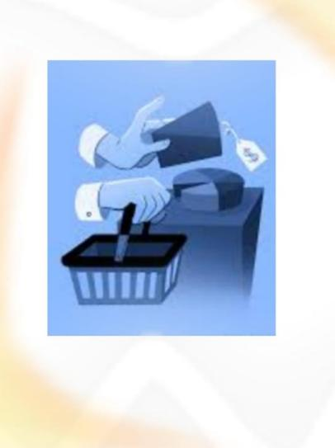
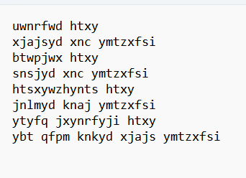

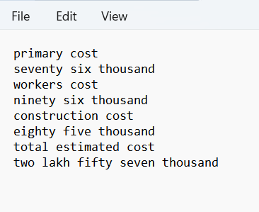
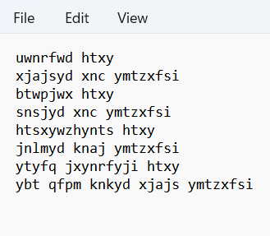
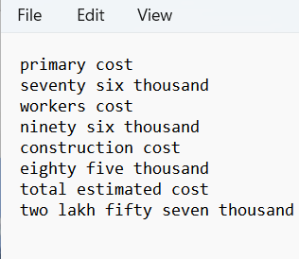
Finance Industry
12

Slide 13
Conclusion
LSB embedding in image steganography offers a potent means to secure industry secrets.
By leveraging this technique, organizations can bolster their data protection strategies and ensure the conﬁdentiality of sensitive information in the digital Era.
13

Slide 14
Thank You !
BALAJI JAYAKRISHNAN
Associate Professor
VIT CHENNAI CAMPUS
Students (VIT CHENNAI CAMPUS )
SANJAY M
ROSHINI R
KANAPARTHI ROSHIN SAI
PILLARAM MANOJ
14
Notes:
BALAJI JAYAKRISHNAN
Associate Professor
VIT Business School Chennai
balaji.jayakrishnan@vit.ac.in

